Slide 1
MACHINE LEARNING SCE
Group-10
SR No | Name | Roll No | Gr No
1 | Achintya Kumar Srivastava | 313001 | 21810744
2 | Shubham Gujar | 313012 | 21810749
3 | Shivam Srivastava | 313043 | 21810428
4 | Jinshel George | 313010 | 21810425
Under the guidance of
Prof. Dr. Tushar R. Jadhav

Slide 2
TOPIC
Pneumonia Detection Using Convolutional Neural Network

Slide 3
INTRODUCTION
Pneumonia is an infection that inflames the air sacs in one or both lungs. The air sacs may fill with fluid or pus (purulent material), causing cough with phlegm or pus, fever, chills, and difficulty breathing. A variety of organisms, including bacteria, viruses and fungi, can cause pneumonia.
Radiography, CT-scan, or MRI is the common method to discover pneumonia. Medical personnel check the patient’s radiograph of their chest to determine if they are infected with pneumonia or not. In addition, the usual method for finding pneumonia is through medical history and laboratory results of the patient.

Slide 4
Radiograph of chest is penetrated through X-rays where the soft tissues produces a dark color and hard tissues like bones produces a bright color.
Patients diagnosed with pneumonia shows the chest cavity signs of fluids filling the air sacs of lungs as for the radiograph picture appears brighter.
To validate the range and spot of an infected area of the lungs, chest x-rays is the utmost method.
The Chest X-Rays of lungs are used to classify whether the person is infected or not using Convolutional Neural Networks.

Slide 5
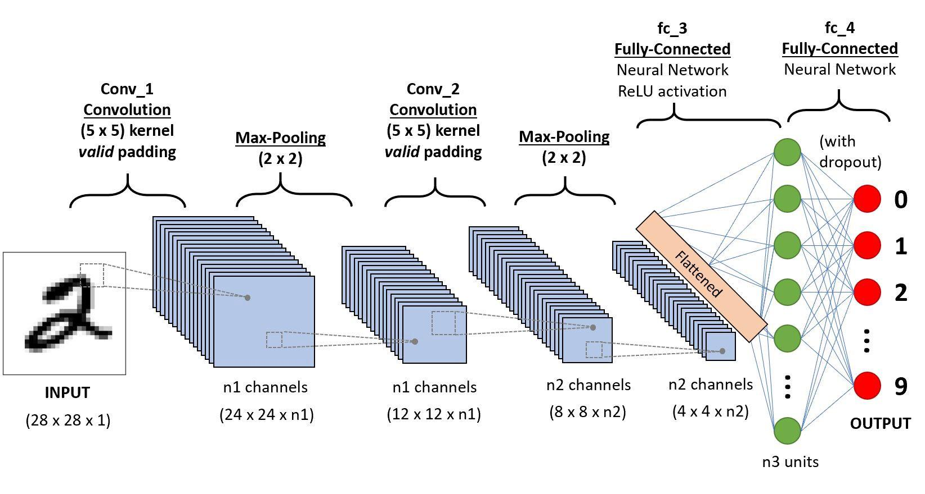
CONVOLUTIONAL NEURAL NETWORKS
Process of CNN is to detect and categorize images from learned features. It is very effective in a multi-layered structure when obtaining and assessing necessary features of graphical images. Following figure illustrates the CNN process.

Slide 6
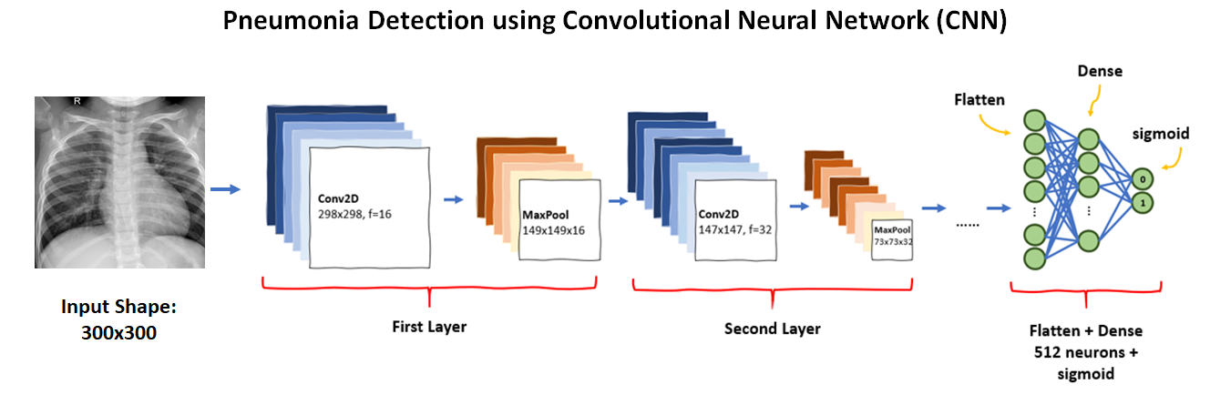

Slide 7
CONVOLUTION LAYER
This layer conceptualizes the characteristics of each image input. It stores three-dimensional connection among pixels by means of discovering significant image characteristics with small squares of image input.
The overall process involves the conversion of the image input into a 5X5 matrix pixel values and the resulting filter is 3x3 matrix or the resulting feature map in this layer.
Feature map contains specific details of the original image necessary to determine an input. The feature map then down sampled with the ReLU method reducing any negative values to zero and remains all others intact.

Slide 8
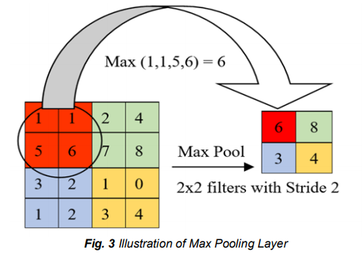
2) MAX-POOLING LAYER
This layer cut down the values further to half of its original value by choosing only max values from the kernel matrix. The sample illustration is the 4x4 matrix pixel values of an input image is degraded into 2x2 filters. This process is described in the below figure.

Slide 9
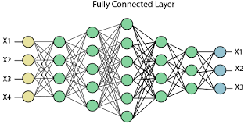
3) FULLY-CONNECTED LAYER
Multi-layer perceptron in this layer confirms that all neurons is interconnected to every neuron of every succeeding layers in the purpose of classifying input images created through the preserved features of image.

Slide 10


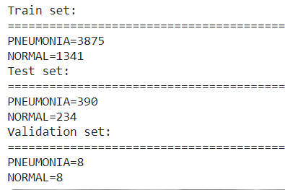
METHODOLOGY
Dataset Preparation:
The dataset utilized is Chest X-Ray Image (Pneumonia) from Kaggle. The dataset has been compiled by CelPress which is an organization that publishes journals and research on earth and health sciences along with other scientific communities.
The dataset contains 5863 chest X-ray images which have been classified into two categories- Normal and Pneumonia.

Slide 11
2) Transfer Learning and Fine-Tuning:
For an effective classification, the models are set for proper setting to the needed task. Transfer learning let the model save to original parameter settings of the previously trained model to bring effective score without using intense computing power. The Fine-Tuning method can extract new features from pneumonia and change the original 1000 neurons for example the VGGNet model to only four. Hyperparameters facilitate the deep learning model to produce significant results just as the actual training procedure takes place. Selecting the exact values can initially make a huge dissimilarity by making hyperparameter tuning a necessary process. Still, there are no precise hyperparameters for every algorithm. Thus, a practical experimentation must take place.

Slide 12
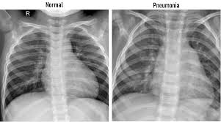
3) Classification:
Every single block of the neural network are used in architecture followed by wholly inter-connected layers and sigmoid activation. Feature extraction is composed of an input image, convolution, max-pooling while classification involves fully interconnected layers and output

Slide 13
MODEL
VGG16 is a convolution neural net (CNN ) architecture which was used to win ILSVRC(Imagenet) competition in 2014. It is considered to be one of the excellent vision model architecture till date.
VGG16 has convolution layers of 3x3 filter with a stride 1 and always used same padding and maxpool layer of 2x2 filter of stride 2. It follows this arrangement of convolution and max pool layers consistently throughout the whole architecture
The 16 in VGG16 refers to it has 16 layers that have weights. This network is a pretty large network and it has about 138 million (approx) parameters.
.

Slide 14
CODE

Slide 15
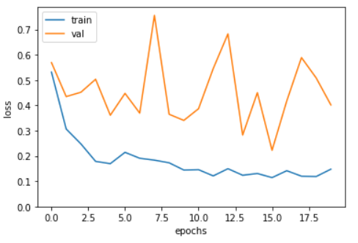
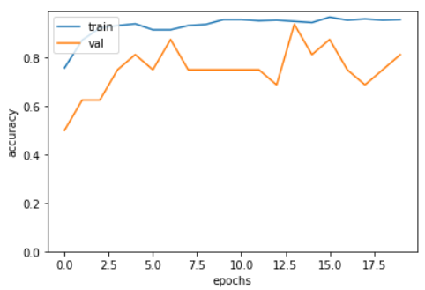
INVESTIGATIONAL RESULTS
Accuracy & Loss graphs

Slide 16
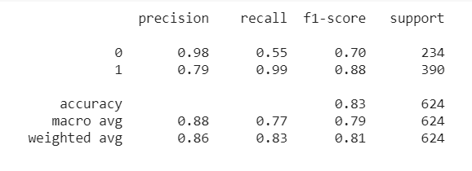
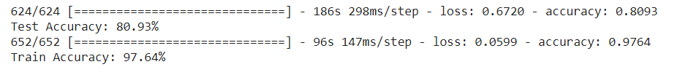
ACCURACY

Slide 17

DEPLOYMENT- https://pneumonia-classifier-cnn.herokuapp.com/

Slide 18
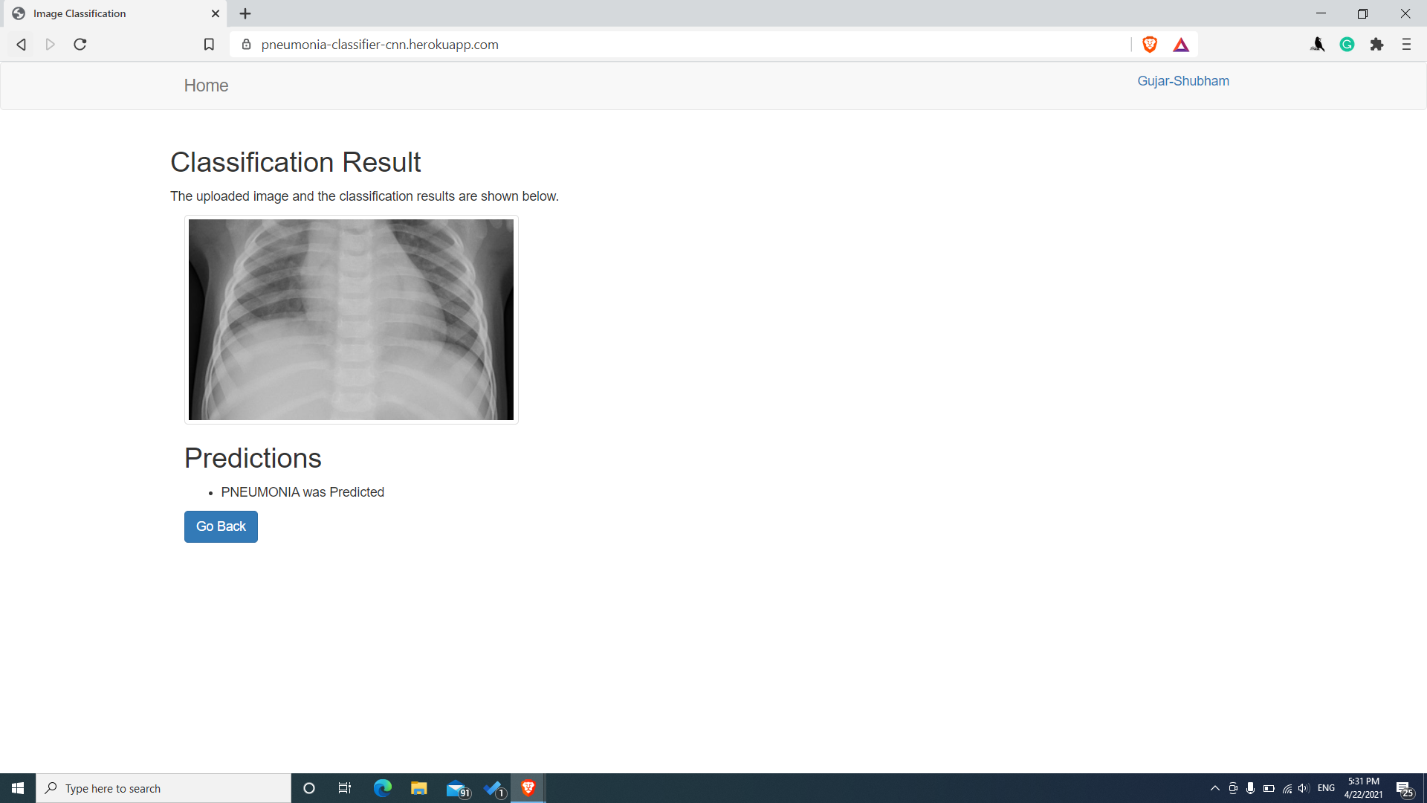

Slide 19
CONCLUSION
The dataset for this project has been taken from kaggle which was provided by CelPress. We used the VGG16 architecture of convolutional neural network to classify the chest X-ray images as normal and pneumonia infected. The test accuracy we got using this model is 80.93%.
With this work, a distinguished process of diagnosing and detecting pneumonia can helpful in providing medical services. Further,medical workforce in their decision making for a real-time application of the use of accurate model in detecting pneumonia and discover the potential of diagnosing pneumonia using deep learning.

Slide 20
REFERENCES
Pneumonia-Detection-Using-Convolutional-Neural-Networks.pdf (ijstr.org)
Chest X-Ray Images (Pneumonia) | Kaggle
https://towardsdatascience.com/step-by-step-vgg16-implementation-in-keras-for-beginners-a833c686ae6c
https://www.pluralsight.com/guides/deploying-image-classification-on-the-web-with-streamlit-and-heroku
Varshni, Dimpy, et al. "Pneumonia detection using CNN based feature extraction." 2019 IEEE International Conference on Electrical, Computer and Communication Technologies (ICECCT). IEEE, 2019.

Slide 21
THANK YOU

